Slide 1
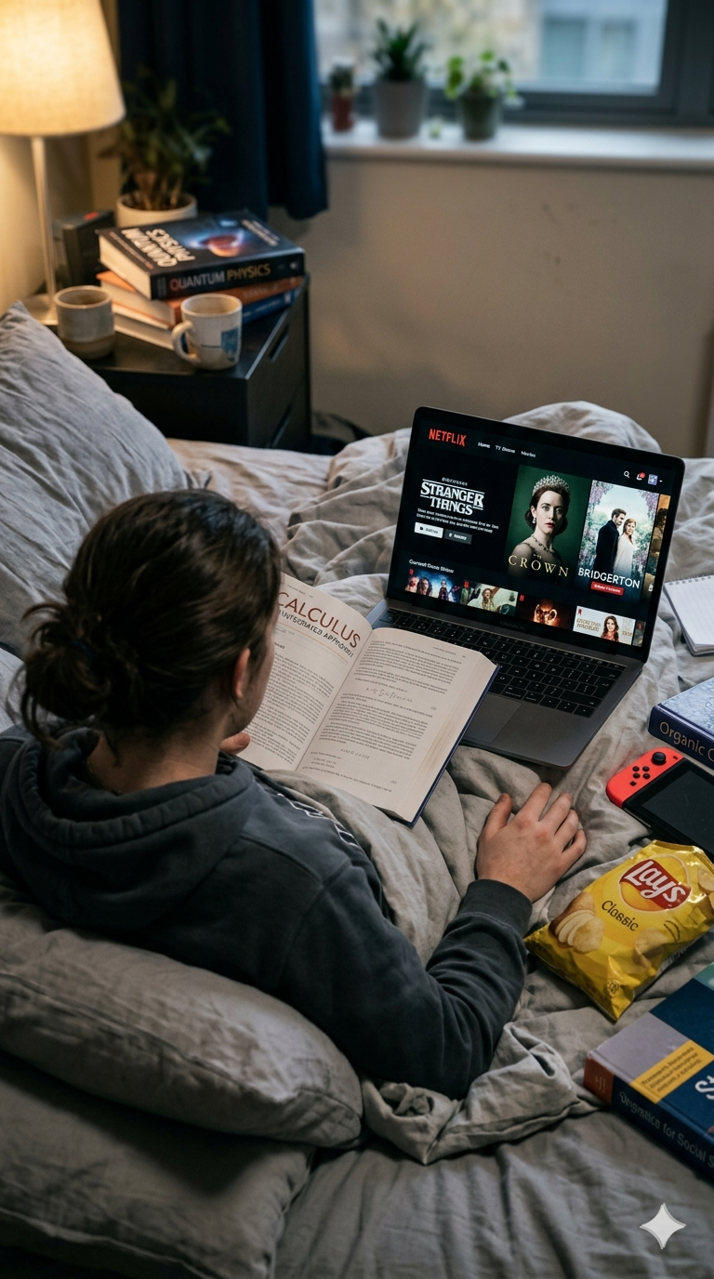
The Impact of Streaming Behaviour on Students' Study Delay During Examination Periods
A Binary Logistic Regression Approach — Analyzing the relationship between streaming platform usage (YouTube, Netflix) and academic procrastination during examination periods
Notes:
1

Slide 2
Problem Statement & Research Objectives
The Problem
Research Objectives
Students use OTT platforms for stress relief during exam prep, but features like auto-play and personalized recommendations transform short breaks into "Over-Watching Behaviour."
Examine the relationship between streaming frequency and study delay
Determine the impact of over-watching on academic procrastination
Estimate study delay probability using Binary Logistic Regression
Analyze behavioural differences across age groups (10–24 years)
Study delay and poor time management
Reduced concentration
Academic procrastination
Notes:
2

Slide 3

Literature Review & Research Gap
What Research Has Found
Research Gaps Identified
Binge-Watching & Procrastination — Binge-watching significantly increases academic procrastination among college students
Time Management Issues — Streaming reduces focus and weakens students' ability to manage study time
Relaxation vs. Escape — Students use streaming for relaxation but frequently get trapped in excessive viewing patterns
Streaming time vs study delay gap
Streaming frequency impact gap
Limited research clearly measures how daily streaming duration during exam preparation directly affects students’ study delay behavior.
Few studies analyze how the frequency of streaming usage influences procrastination or study postponement during exams.
6 studies reviewed · 270+ sample size · 90%+ millennials who binge-watch
Over-Watching Behaviour Gap
Age-wise behavioral difference gap
Very few studies compare how different age groups vary in study delay due to streaming habits during exam preparation
Limited examination of attention control and continued watching
Notes:
3

Slide 4


Key Literature Reviewed
Author(s) & Year
Research Paper Title
Major Finding
Yolie & Hastuti (2024)
Binge-Watching Habits & Academic Procrastination
Binge-watching significantly increases academic procrastination
Kastiya & Sharma (2025)
Impact of Binge Watching on Academic Procrastination
Increased streaming reduces concentration, productivity, and study discipline
Prakasha et al. (2024)
OTT Platform Usage Affecting Academic Profile
OTT usage weakens time management and academic focus
Heliyon Study (2024)
Factors Determining Binge-Watching Motivations
Entertainment, relaxation, and escapism are major binge-watching drivers
Goulas & Megalokonomou (2018)
Effects of Exam Scheduling on Performance
Long exam schedules increase cognitive fatigue and affect performance
Collis & Eggers (2022)
Restricting Social Media on Wellbeing & Performance
Students substitute restricted social media with streaming activities
Notes:
4

Slide 5
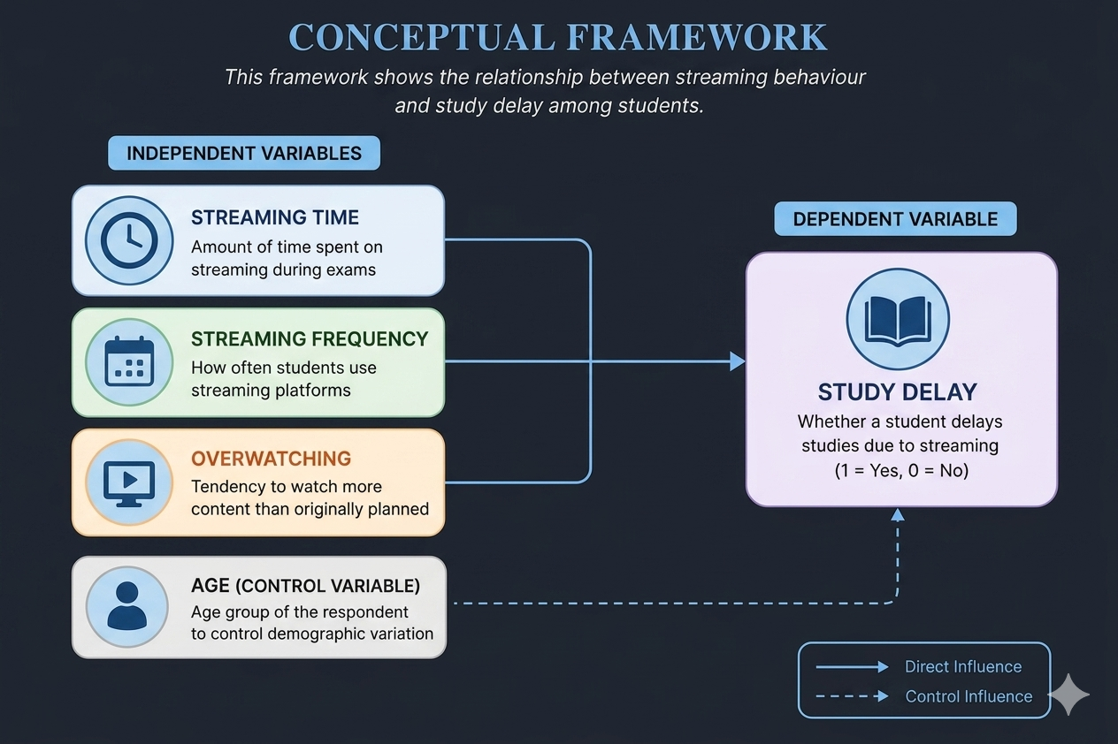

Hypothesis & Methodology
H₀ — Null Hypothesis
H₁ — Alternative Hypothesis
Streaming behaviour has no significant effect on study delay.
Streaming behaviour has a significant positive effect on study delay.
Methodology
Primary data via structured Google Forms questionnaire
Convenience sampling technique
117 valid responses — 93 college, 24 school students
Age group: 10–24 years
Binary Logistic Regression for analysis
Notes:
5

Slide 6
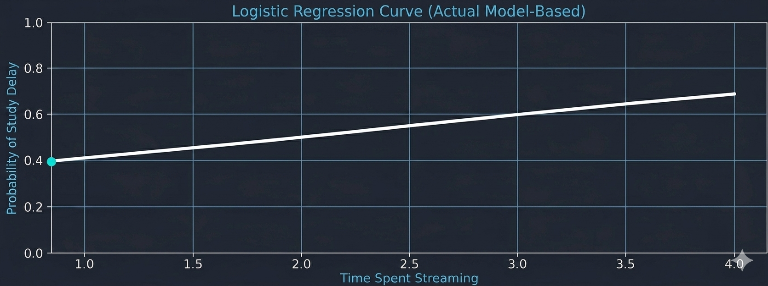
Variables & Model Analysis
Binary Logistic Regression Model
Variable Summary
Dependent Variable
Variable
Type
Expected Effect
Study Delay — Binary outcome: 1 = Delayed, 0 = Not Delayed
Streaming Time
Independent
Positive (+)
Overwatching Behavior
Independent
Positive (+)
Streaming Frequency
Independent
Neutral / Positive
Age
Control
Negative (–)
Notes:
6

Slide 7
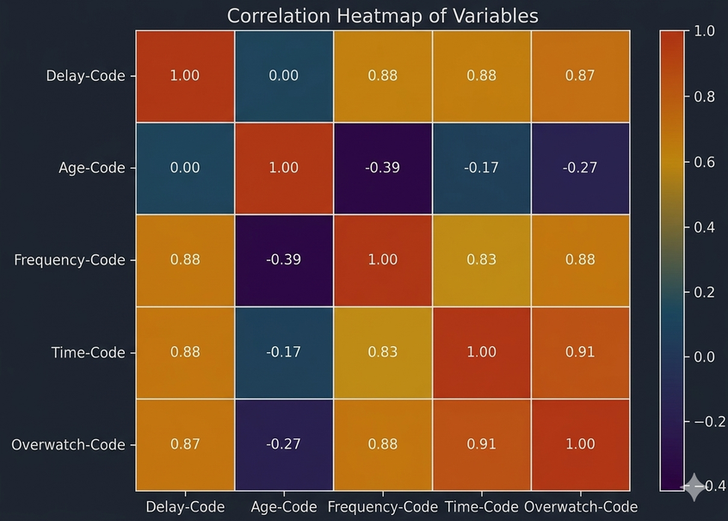
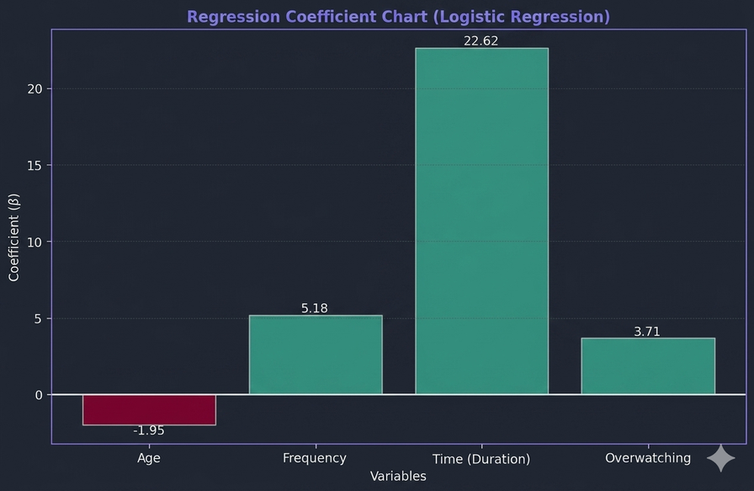
Quantitative Analysis
Key Findings
Regression Results
Streaming Time
Variable
Coefficient
P-Value
Significantly increases study delay (p = 0.049)
Age
–0.031
0.897
Frequency
0.363
0.227
Null Hypothesis Rejected
Streaming Time
0.384
0.049 ✓
Streaming behaviour significantly affects study delay
Overwatching
0.490
0.019 ✓
No severe multicollinearity detected. Streaming Time and Overwatching show positive association with Study Delay.
Overwatching
Strongest behavioural effect (p = 0.019) — students who lose control over streaming are more likely to postpone studies
Notes:
7

Slide 8
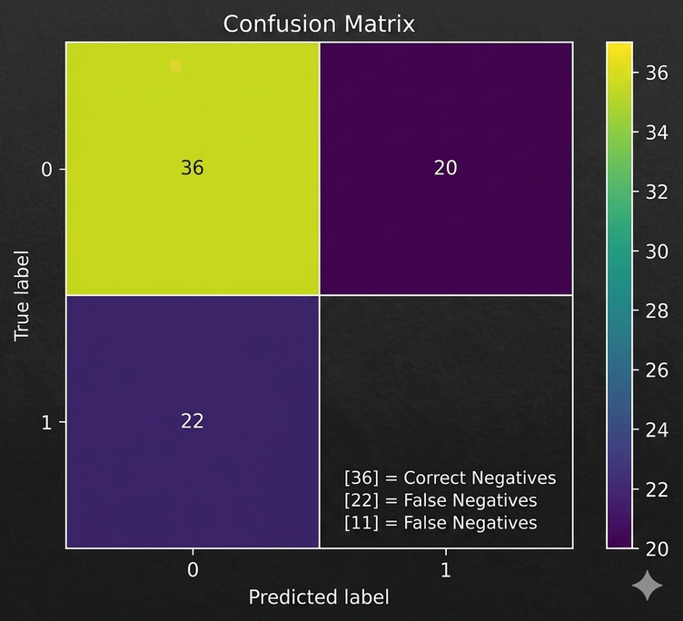
Model Validation & Hypothesis Testing
Model Validation
63.5%
0.0086
Accuracy Score
Likelihood Ratio p-value
Model reasonably predicts study delay behaviour
Model statistically significant overall
Hypothesis Testing
Since both Streaming Time (p = 0.049) and Overwatching (p = 0.019) are statistically significant:
Reject H₀
Accept H₁
Streaming behaviour has no significant effect on study delay
Streaming behaviour significantly affects study delay among students
Notes:
8

Slide 9
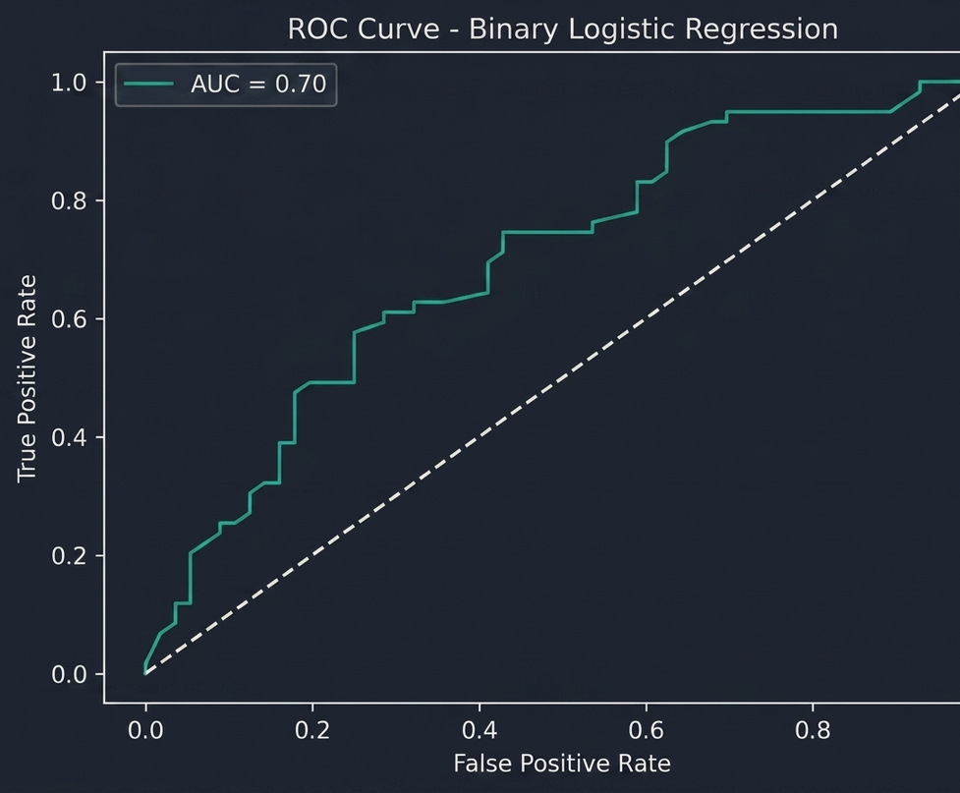
Model Diagnostics
Multicollinearity Check (VIF)
Variance Inflation Factor (VIF) test was conducted to check multicollinearity among predictors.
All VIF values were close to 1.
Model Performance
ROC Curve Analysis
Area Under Curve (AUC) = 0.695
Classification Report:
Precision: 0.65
Recall: 0.63
F1-score: 0.64
Diagnostic results confirm that the model is statistically stable and reliable for behavioural prediction of study delay.
Notes:
3

Slide 10



Qualitative Analysis
Key Insights
Behavioural Themes Identified
Present Bias
Distraction and reduced focus
Overwatching behaviour and time mismanagement
Academic procrastination and entertainment dependence
Loss of self-control and reduced study consistency
Students prioritize immediate entertainment over long-term academic goals
Dopamine-Driven Behaviour
Student Voices
Entertainment platforms trigger reward cycles that undermine study discipline
"One episode turns into hours."
Parental Control Effect
School students reported improved focus when parents restricted devices during exams
"Streaming feels more rewarding than studying."
"Auto-play makes it difficult to stop watching."
Notes:
9

Slide 11
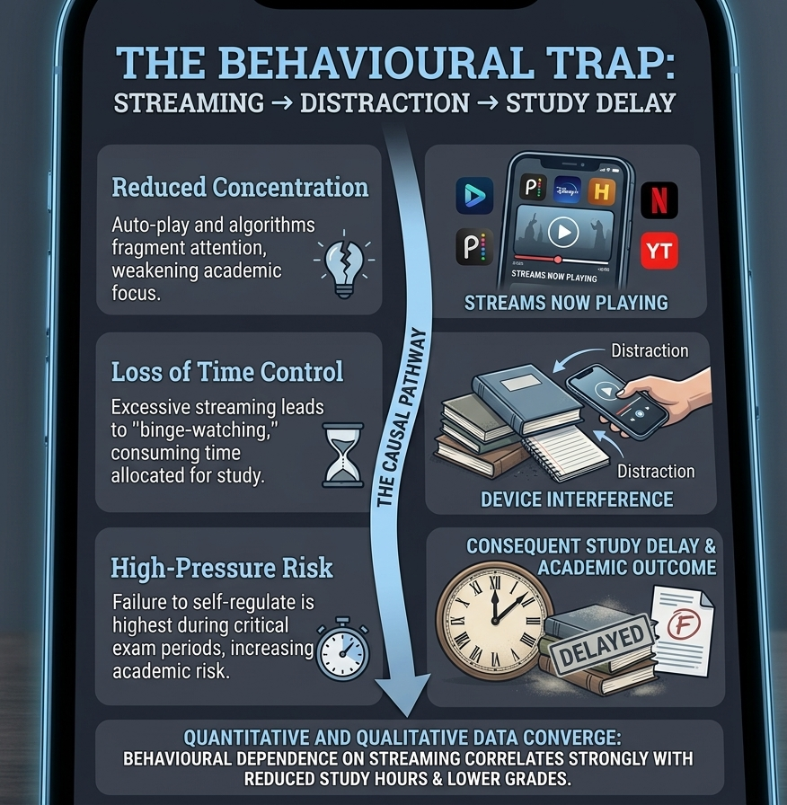
Overall Analysis & Conclusion
Study Delay
Excessive streaming directly contributes to postponed study sessions during exam periods
Reduced Concentration
Auto-play and recommendations fragment attention and weaken academic focus
Overwatching is Key
Loss of time control over streaming emerged as the strongest behavioural predictor
High-Pressure Risk
Students fail to self-regulate most during high-stakes examination periods
Both quantitative and qualitative findings converge: behavioural dependence on streaming platforms negatively affects academic discipline, with overwatching as the critical factor. Students must develop self-regulation strategies to protect study time during exam periods.
Notes:
10

